Slide 1
回顾: Three formulations of the sequence anomaly detection problem (1)
For the first formulation (SEQUENCE-BASED ANOMALY DETECTION), an entire sequence is anomalous if it is significantly different from normal sequences.
针对何为normal sequences？产生两个不同的定义

Slide 2
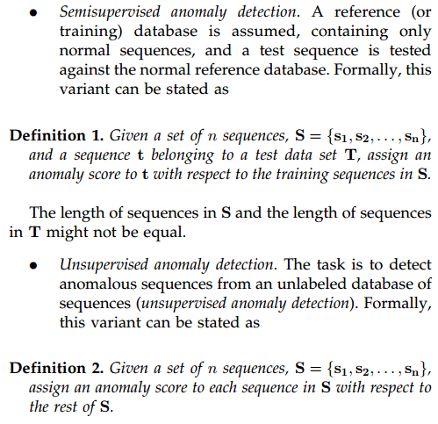

Slide 3
回顾: Three formulations of the sequence anomaly detection problem (2)
For the second formulation (CONTIGUOUS SUBSEQUENCE-BASED ANOMALY DETECTION), a contiguous subsequence within a long sequence is anomalous if it is significantly different from other subsequences in the same sequence.

Slide 4
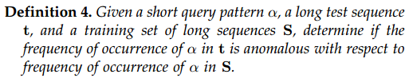
回顾: Three formulations of the sequence anomaly detection problem (3)
For the third formulation (PATTERN FREQUENCY-BASED ANOMALY DETECTION), a given test pattern is anomalous if its frequency of occurrence in a test sequence is significantly different from its expected frequency in a normal sequence. (pattern -> 用户指定的subsequence)

Slide 5
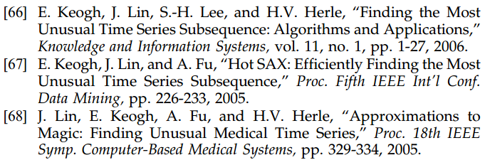
连续时间序列异常检测相关文章
Continuous Subsequence-based Anomaly Detection (Basic technique is at the heart of a number of techniques investigated by Keogh)

Slide 6
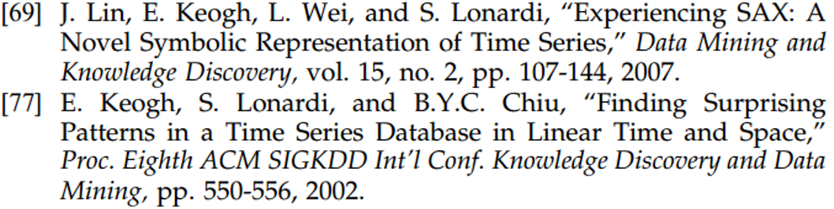
连续时间序列异常检测相关文章
Pattern Frequency-based Anomaly Detection(This problem has also been referred to as surprise detection in the context of time series data)

Slide 7
Continuous Subsequence-based Anomaly Detection
67，68都是在66前一年发表的。这两篇文章内容相似，都是介绍了HOT SAX方法，只是在文章的结构和内容上稍有调整，然后在作者顺序上有所调换。而这篇文章则是这两篇文章的一个扩充版本（算法介绍更详细，实验各全面），本周主要阅读的就是66这篇。

Slide 8
Finding the most unusual time series subsequence: algorithms and applications
Jorfun

Slide 9
目录
相关概念
解决的问题
提出的方法
方法效果
个人想法

Slide 10
time series discords
Time series discords are subsequences of longer time series that are maximally different to all the rest of the time series subsequences. They thus capture the sense of the most unusual subsequence within a time series.

Slide 11
trivial matches
In general, the best matches to a subsequence (apart from itself) tend to be located one or two points to the left or the right of the subsequence in question. Such matches have previously been called trivial matches.

Slide 12
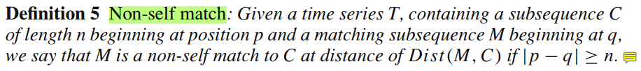
non-self match

Slide 13
目录
相关概念
解决的问题
提出的方法
方法效果
个人想法

Slide 14
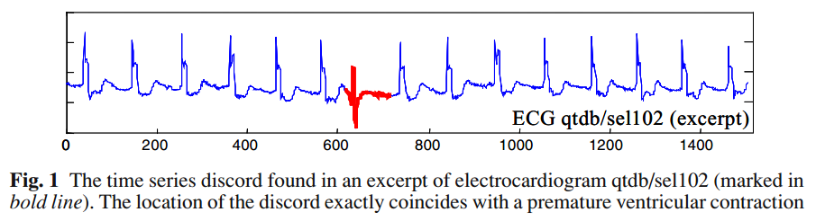
finding time series discords
In this work, we pose the new problem of finding the sequence that is least similar to all other sequences. We call such sequences time series discords.

Slide 15
目录
相关概念
解决的问题
提出的方法
方法效果
个人想法

Slide 16
HOT SAX(Heuristically Ordered Time series using Symbolic Aggregate Approximation)
The brute-force algorithm to discover the most unusual subsequence requires a quadratic “all to all” comparison, which is untenable for large real-world datasets. We introduce a simple algorithm that can achieve three to four orders of magnitude speedup on real problems. Our algorithm works by admissibly pruning off some fruitless calculations, and using heuristics to reorder the search such that as many fruitless calculations are pruned as possible.

Slide 17
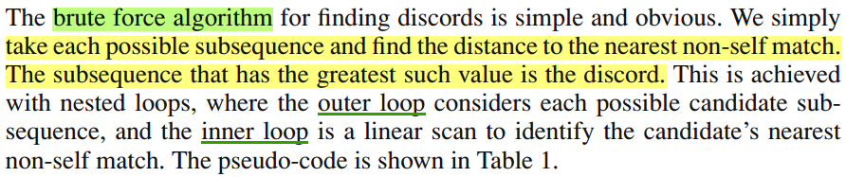
Brute force(simplest way)
The algorithm requires exactly one parameter, the length of subsequences to consider.

Slide 18
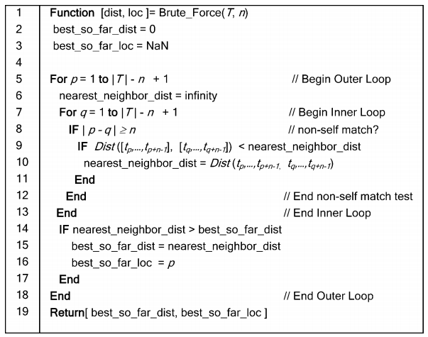
当前最可能为discord的子序列位置和与其最近邻的距离值
Brute force
discord discovery
Discord判断基准：Non-self distance to the nearest neighbor

Slide 19

改进算法的入手点
不用计算完每个subsequence的所有nearest non-self match，只要在inner loop中存在比best_so_far_dist更小的距离就足够说明该段子序列不会是discord，此时就可以排除该subsequence是discord的可能性。
上面这个优化技术的效果与内外层循环遍历subsequence的顺序有很大的关系。

Slide 20
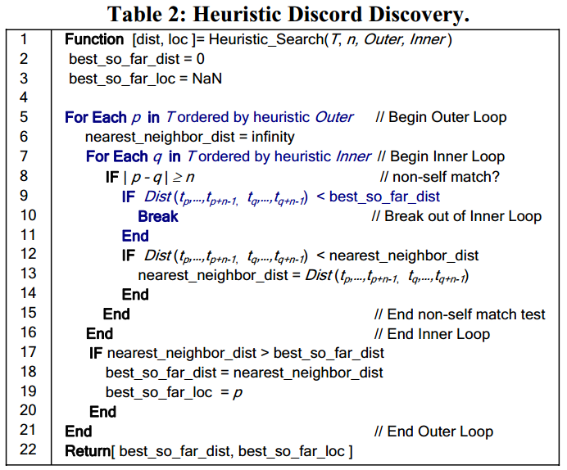
Heuristic
Discord
Discovery

Slide 21
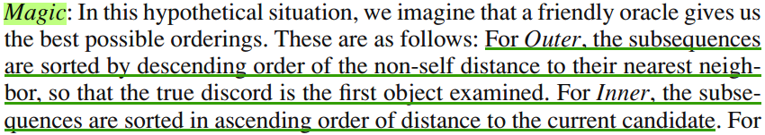
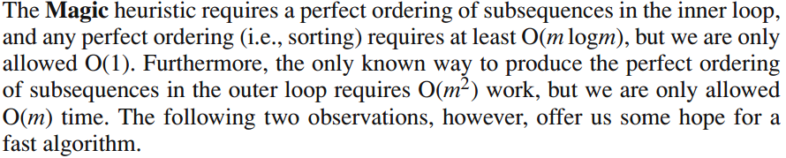
关于Heuristic策略的思考
达到magic所需的时间代价

Slide 22
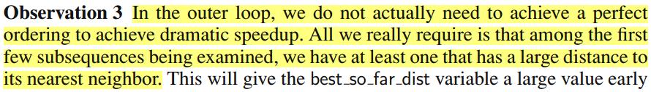
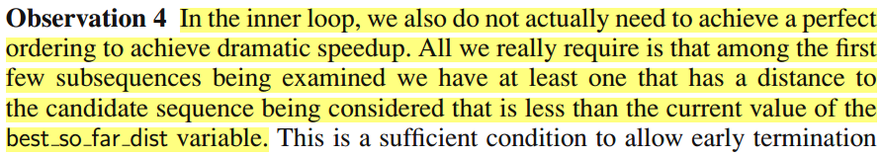
We could Approximate the magic heuristic

Slide 23
Before introducing how to Approximate the magic heuristic
Representation of time series
Piecewise Aggregate Approximation (PAA)
Symbolic Aggregate Approximation (SAX)

Slide 24
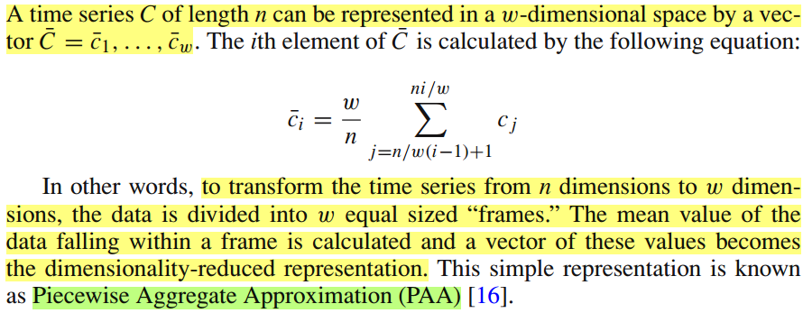
Piecewise Aggregate Approximation (PAA)

Slide 25

Symbolic Aggregate Approximation (SAX)
PAA representation -> discrete representation (word)
需要设置两个参数
字母表大小
单词长度（在PAA中就会用到）

Slide 26
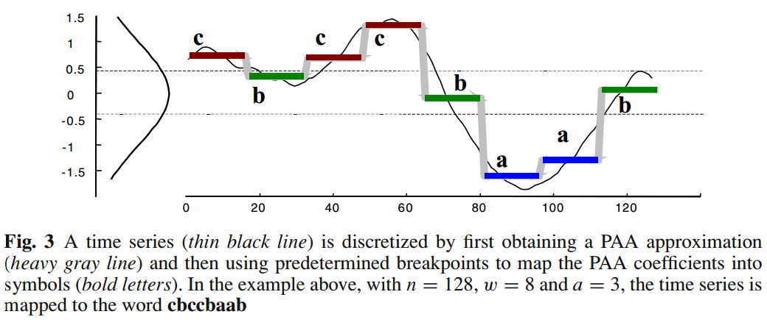
Symbolic Aggregate Approximation (SAX)

Slide 27
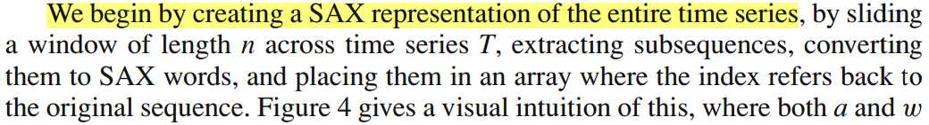
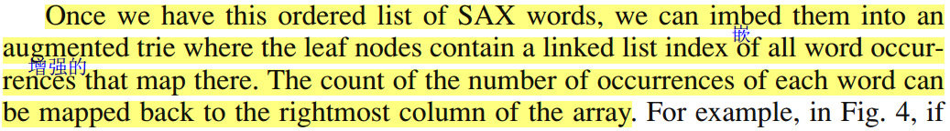
Approximating Magic Outer & Inner loop
需要两个数据结构: 1. Array 2.Trie

Slide 28
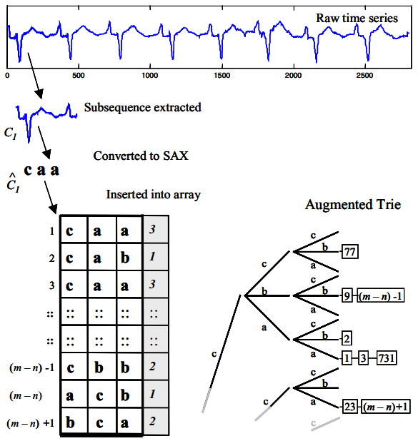

Slide 29
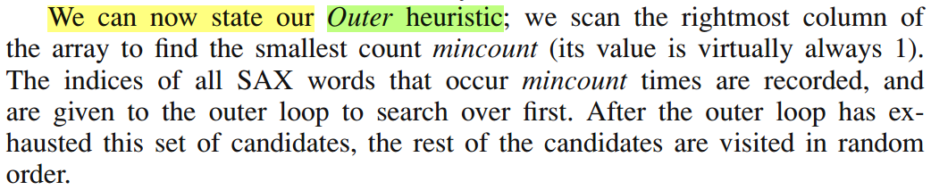
Outer heuristic
Only need data structure array

Slide 30
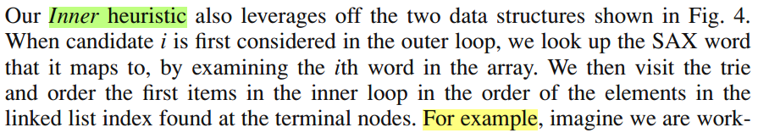
Inner heuristic
Need both two structures

Slide 31
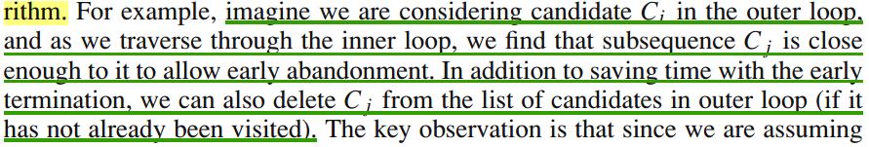
Minor optimizations

Slide 32
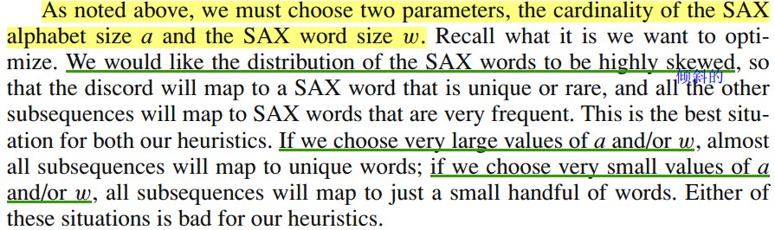
Parameter setting

Slide 33
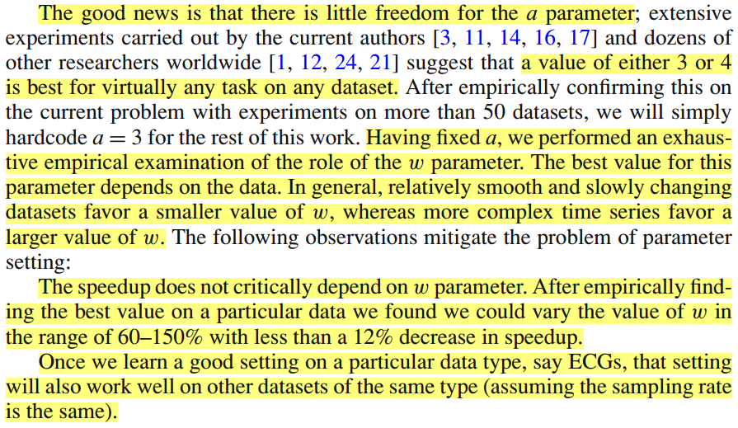

Slide 34
目录
相关概念
解决的问题
提出的方法
方法效果
个人想法

Slide 35
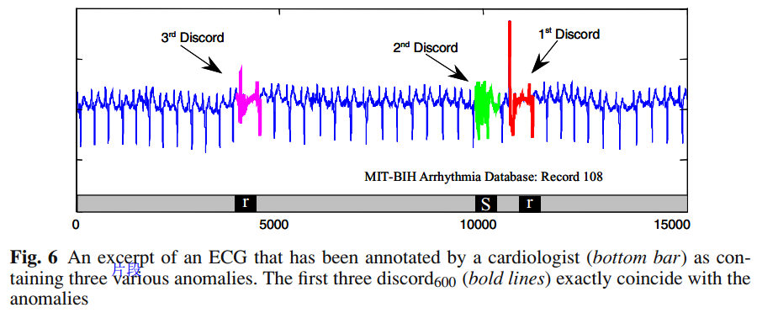
Anomaly detection in electrocardiograms

Slide 36
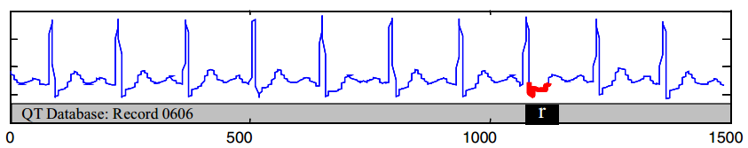
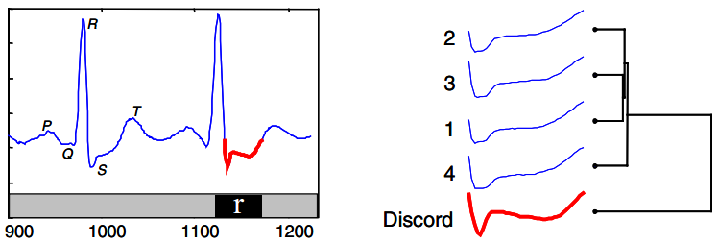

Slide 37
Change detection in patient monitoring
Investigated a time series showing a patient’s respiration (measured by thorax extension), as they wake up.

Slide 38
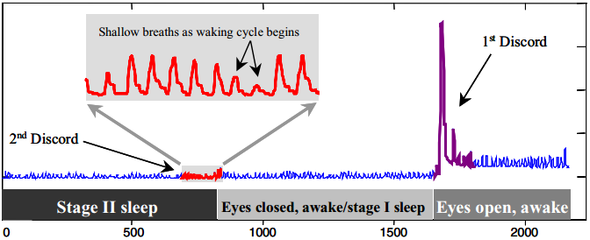

Slide 39
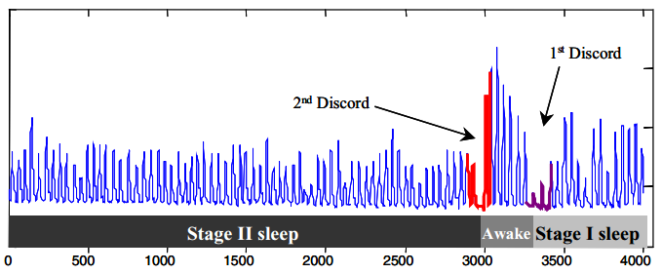

Slide 40
Shape database exploration
In this experiment we consider a primatological dataset
converting shapes to time series
the subsequences could come from any collection of individual subsequences, so long as they are all of the same length

Slide 41
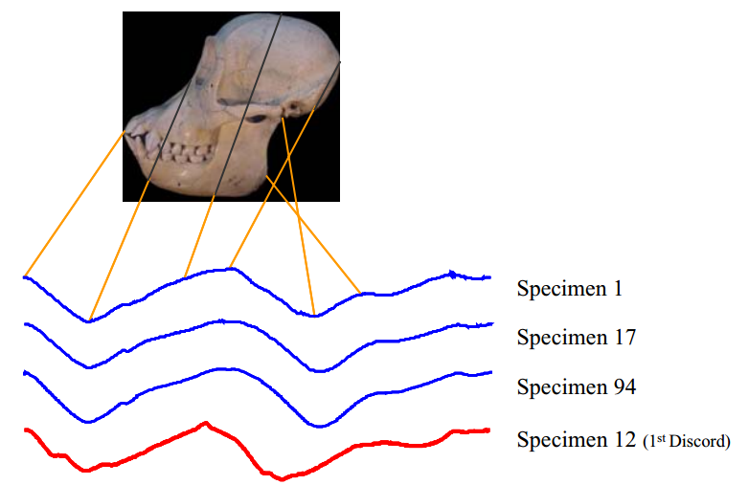
A shape can be converted to a time series by examining the local curative of the perimeter.

Slide 42
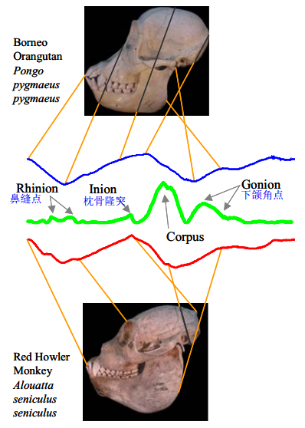

Slide 43
Video data exploration
A time series was extracted from a video of an actor performing various actions with and without a replica gun. The time series measures the Y –coordinate of the actor’s right hand.

Slide 44
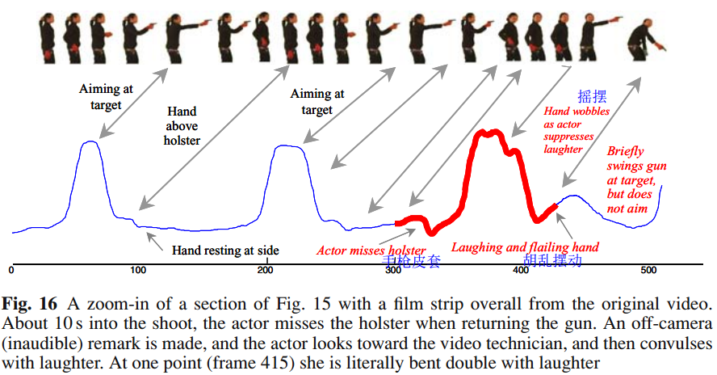

Slide 45
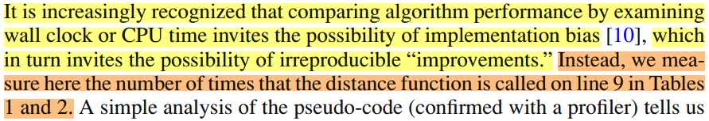
The utility of HOT SAX search
通过实验了解相对于brute force的效率提升
为什么不跟其他算法比较？
参数个数差异
只有测试集

Slide 46
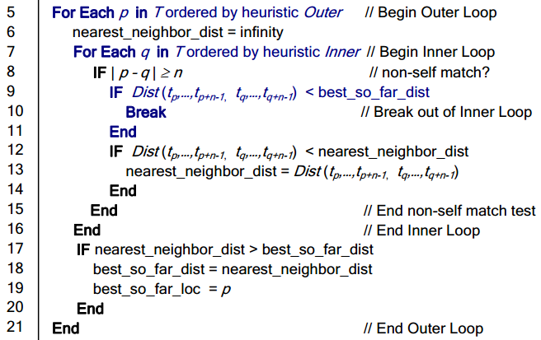

Slide 47
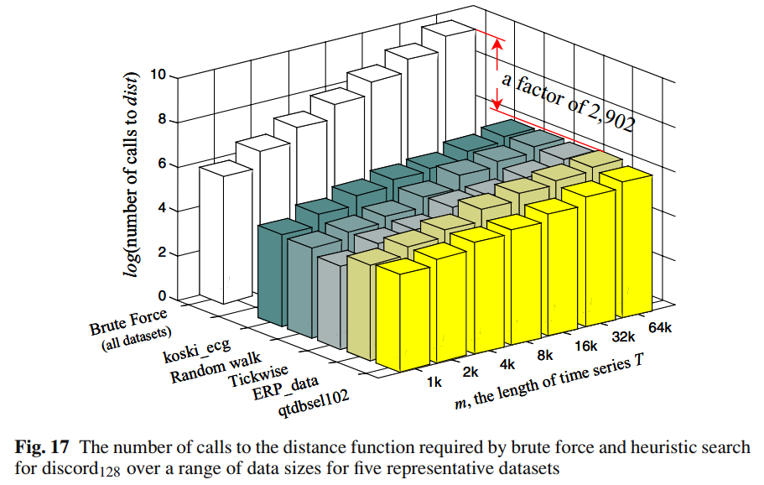

Slide 48
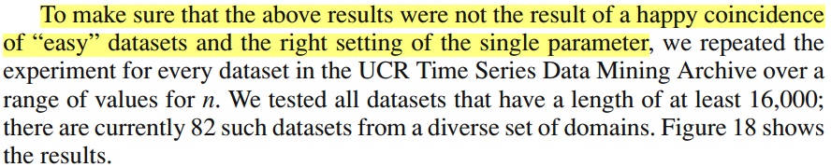
The utility of HOT SAX search

Slide 49
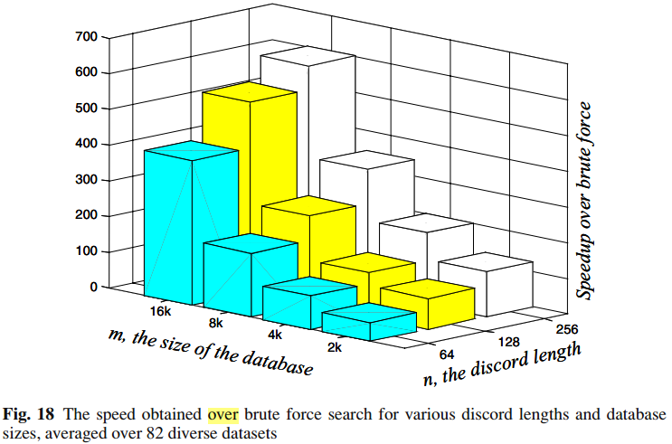

Slide 50
目录
相关概念
解决的问题
提出的方法
方法效果
个人想法

Slide 51
个人想法
多个discord（实验中有出现）
Outer heuristic: find the smallest count 换成top-X smallest count
Inner heuristic: 也考虑尾字母不同的word
换一个距离度量
关于心率数据的应用考虑
不适合多种状态混合的序列（除非把不同状态下的序列分割出来）
适用于有稳定模式的序列分析（跑步忽快忽慢）

